Slide 1


Machine Learning: Looking for the meaning of our data
Diego Poza @diegopoza
Content Marketing @auth0

Slide 2
Agenda
What is Machine Learning?
Azure Machine Learning
Demo: Creating a Machine Learning Web Service
Demo: Twitter Sentiment Analysis

Slide 3
What is Machine Learning?
Computing systems that become smarter with “experience”
Experience = past data + human input
They are able to independently adapt and “learn”
It uses study algorithms that learn from data without the need to program individual rules
Goal: predict what the likely outcome is going to be (insights)
Useful in cases where designing and programming explicit algorithms is infeasible
When (big) data-driven decisions tend to be better decisions

Slide 4
Machine Learning usage
Involves induction, for complex models (non lineal)
Useful for Big Data
For learning patterns in data
To predict results (insights) and help make better business decisions
Three broad categories
Supervised learning
Unsupervised learning
Reinforcement learning
Techniques: classification, clustering, regression (prediction)
Abstraction of data
Related fields: statistics, artificial intelligence, modeling, data mining
Notes:
Useful when: Human expertise does not exist or is hard to “expain” (speech recognition, you don’t have to be a “master of backgammon” to create a backgammon game) Solution changes in time Solution needs to be adapted to particular cases Three broad categories
Supervised learning: use training data to “map” input and output data (labeled data)
Unsupervised learning: data with no labels, the goal is to find relationship in the data
Reinforcement learning: the algorithm gets to choose an action in response to each data point. Then it modifies its strategy in order to achieve the highest reward (robotics, IoT).

Slide 5
Examples

Slide 6
Machine Learning examples
Online movie recommendation on Netflix (“The Netflix price”, offered $1M to improve accuracy by 10%)
Spam filtering, which uses text classification techniques (like Naive Bayes spam filtering)
Google’s self-driving cars, which use Computer vision, image processing and machine learning algorithms to learn from actual drivers’ behavior.
Notes:
Other cases: Image search (similarity Fraud detection (credit card providers) Decision making (bank/insurance sector) Speech understanding (Siri, Cortana)
Face detection (Facebook’s photo tagging)

Slide 7
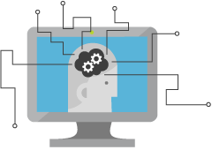
Azure Machine Learning
Cloud-based predictive analytics service
Provides a collaborative tool with drag & drop
Publish ready-to-consume web services
Large library of well-known algorithms and data sets
Gallery of experiments and samples
Ready-to-consume web services from the Azure Marketplace

Slide 8



Data
Clients
API
Blobs and Tables
Hadoop (HDInsight)
Relational DB (Azure SQL DB)
Integrated development environment for Machine Learning
Model is now a web service that is callable

Slide 9
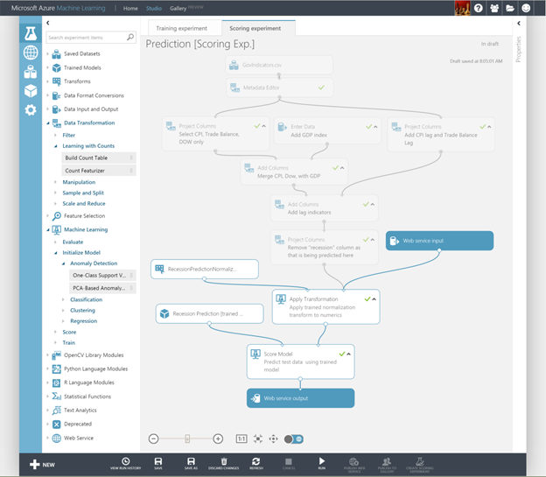
Azure ML Studio
https://studio.azureml.net
Collaborative, drag-and-drop tool to manage Experiments
No programming required
Use sample datasets or upload
Use sample modules (algorithms) or program your own using R and Python
Publish your experiments to a web service
Notes:
https://azure.microsoft.com/en-us/documentation/articles/machine-learning-data-science-how-to-create-machine-learning-service/

Slide 10
Demo
Creating a Machine Learning Web Service

Slide 11
Scenario
German Credit Card UCI dataset: 1000 rows of data.
Bank customers request credits, and the model should predict if the operation has low or high risk.
“1” is low-risk
“2” is high-risk
Notes:
Dataset URL: http://archive.ics.uci.edu/ml/datasets/Statlog+(German+Credit+Data)

Slide 12

Predictive Experiment
Get the data
Pre-process the data
Define features
Upload your dataset (CSV, TSV, text)
Read existing dataset (HTTP, Azure SQL/Table/Blob)
Use sample datasets
Pre-processing Modules
Project Columns
Clean Missing Data
Normalize Data
Metadata Editor
A feature is a property of an entity.
Choose a subset of features that are relevant to the scenario.
Train the Model
Create Scoring Experiment
Publish Web Service
Choose the prediction algorithm.
The two most important algorithm types are classification and regression.
Once the model is trained, you can create a scoring experiment
Elements only used for training are removed
A service endpoint is created to consume the service
An Excel Workbook is created to see how the values change the output real-time
Notes:
Dataset URL: http://archive.ics.uci.edu/ml/datasets/Statlog+(German+Credit+Data)

Slide 13
Q & A

Slide 14
Twitter Sentiment Analysis http://smartddc.azurewebsites.net/

Slide 15
Vielen Dank! You can find samples shown in the presentation here: https://github.com/diegopoza/MachineLearning

